Slide 1
Chapter 3 Memory Neural Networks

Slide 2
Memory Neural networks(MNNs):
NNs which associate an explicit input pattern or Implicit sequenced patterns to a target pattern (Supervised Learning )
* such NNs make memories for pattern association.
Repeating if it is required
Feed Forward NN
Explicit Pattern
x
y
Target pattern
Implicit Sequenced Patterns
x₁….x₂…x₃…x_{N}
Patterns are taken sequentially through the time
Recurrent NN
y
Target pattern

Slide 3
Applications of MNNs:
Natural NNs have high capability in pattern associations.
Inspiring from natural neural networks, MNNs have been utilized in:
Identification
To associate biometric signals (face/finger print/IRIS/hand geometry/body…) to man/animal/plant.
To associate signature, handwriting or speech to certain people.
Character recognition(OCR)
Translation machines
Prediction
To predict samples of temporal signal : finance sys./energy sys./natural sys,…
To predict words of a text in a writing process.
To predict a part of a speech.
To predict frames of a movie.
Modeling walking and moving of different people/animals/phenomena
Learning in Social Robots to path planning and interact with environment.
Image Captioning ,Video or Image Descriptions
….

Slide 4
Challenges in learning of MNNs
MNNs with explicit input patterns
Each explicit input pattern may be deformed, or partially presented.
Each explicit input pattern may disturbed with noise.
MNNs with implicit sequenced patterns
The implicit sequenced patterns may be presented with different lengths.
The implicit sequenced patterns may be combined with disturbance and non-relevant patterns.
Among the sequenced patterns, it may be short and long dependencies.
* MNNs make robust memories against distortion, disturbances and dimension variations of input patterns.

Slide 5
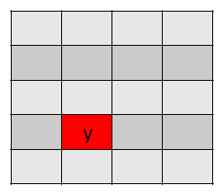
Interpretation 1: A MNN is like a “look-up table”
(1) A MNN acts like a “look-up table” where by applying the indices of a cell as the input pattern, the content of the cell is come out as the output pattern.
x₁
y
x₂
x₁
x₂
* Actually, in such look-up tables the indices are not exactly known, they may deformed, disturbed or partially presented or even the number of indices may be changed.

Slide 6
Interpretation 2: A MNN is like a mapping network
(1) A MNN makes a map in which, each output pattern is represented by a quantized level or a local extremum point and the corresponding input pattern with all possible changes makes its domain of attraction.
Feed-Froward
Quantized map
output
x
x
Domain Attraction in black line
input
y
y
repeating
Recurrent
Analogue map
output
x
input
y
x
Domain Attraction in black line
y

Slide 7
2.1 MNNs with explicit input patterns
The input pattern has a known dimension and it is considered as the main input of the network. (Quantized map)
Simple Feed-Forward MNN
One layer Hetro-Associative and Auto-Associative Networks
Heb Learning method for simple Non-Iterative MNN
Simple Recurrent MNNs
Auto-Associator With Threshold Function (Iterative Hetro-Associative Network)
Hopfield Network (Iterative Associative Network)
Bidirectional MNNs (Iterative Hetro-Associative Network)
MNNs by using Classifiers: MLP, DBNNs and CNNs

Slide 8

One layer Feed-Forward Network for pattern association
x₁
y₁
Input pattern:
Output pattern:
Weight Matrix
x_{i}
y_{j}
Activation Function: Sign Function
Output Patterns: Bipolar/Binary
x_{n}
y_{m}
Auto-Associative Memory : the output patterns and the input patterns are the same in the learning phase. However, in the real cases, the input pattern is deformed or disturbed with noise.
Hetro-Associative Memory : the output patterns and the input patterns are not the same in learning phase but in real cases the input patterns are deformed or disturbed
Aim: the weight matrix W is learned in order that for each pair of input-output Patterns: (s(p),t(p)), (p=1..P), y =f(s(p)^{T}W)→t(p)

Slide 9

Pattern Association Algorithm by Hebbian Learning Rule
Step1: Initialize the weight matrix: w_{ij}=0 (i=1..n, j=1…m)
Step2: For each input-output pair ({s(p),t(p)}, p=1,2,….,P) do following steps: s^{T}=[s₁ …s_{i}…s_{n}] t^{T}=[t₁….t_{j}….t_{m}]
Step3: For i=1…n s_{i} →x_{i}
Step4: For j=1…m t_{j} →y_{j}
Step5: w_{ij}⁺ :=w_{ij}⁻+x_{i}y_{j}
_{End}
*It can be shown that the weight matrix is sum of the outer-products of input –output patterns:

Slide 10
Sufficient Conditions for Pattern Association by Hebbian learning rule
If all input patterns are orthogonal together then their target patterns will be associated by the network :
If (1) each pair of input patterns, which have different target patterns, are orthogonal together and (2) inner product of each pair of input patterns, which have the same target patterns, is positive, then their target patterns will be associated by the network :

Slide 11

Input Pattern with disturbance
If the input pattern s(p) is added by a disturbance
Then the output pattern is computed as follows:
where
To associate true output patter it is enough:
A sufficient condition for output-disturbance can be computed as follows:
A sufficient condition for input-disturbance can be computed as follows :
As a result:

Slide 12





Example(1)
P=4
S(1)^{T}=[1 0 0 0]→t(1)^{T}=[1 0]
S(2)^{T}=[1 1 0 0]→t(2)^{T}=[1 0]
S(3)^{T}=[0 0 0 1]→t(3)^{T}=[0 1]
S(4)^{T}=[0 0 1 1]→t(4)^{T}=[0 1]
S(p)
t(p)
m=2
W=s(1) t(1)^{T}+s(2) t(2)^{T}+s(3) t(3)^{T}+s(4) t(4)^{T}
n=4

Slide 13







Example(2) character Recognition
n=63
m=15
S(A)^{T}=[-1 -1 -1 1 -1….-1-1 1]_{63*1}
t(A)^{T}=[-1 1 -1 ….1-1 1]_{15*1}
S(B)
t(B)
S(C)
t(C)
$$W=S\left(A\right)t{\left(A\right)}^{T}+S\left(B\right)t{\left(B\right)}^{T}+S\left(C\right)t{\left(C\right)}^{T}$$
It works for three characters

Slide 14
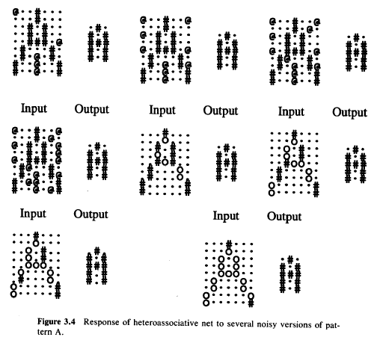
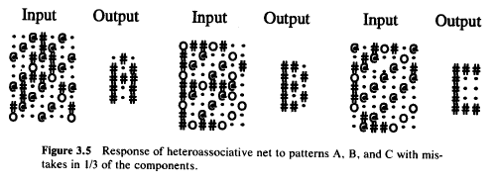
Network Evaluation with disturbed input patterns

Slide 15
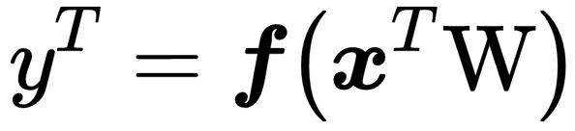
Auto-Associative Memory Network
x₁
y₁
Input pattern:
Output pattern:
x_{i}
y_{j}
Weight Matrix
Activation Function: Sign Function
Output Patterns: Bipolar/Binary
x_{n}
y_{n}
Such Networks are similar to Auto Encoders but dimensionality reduction is not the main purpose. Here, retrieving an original pattern from its disturbed or deformed form is the main goal.

Slide 16


Modified Hebbian learning rule for Auto-associative Networks
Hebbian learning rule
Such weigh matrix (p.s.d (positive semi definite) and symmetric) causes that a self-associative network can make memory for “p “ orthogonal binary or bipolar patterns:
If “P” is increased then it can be shown that for bipolar patterns the weigh matrix becomes nearer to an Identify matrix. Hence, the capability of the network in associating the disturbed or deformed memorized patterns to their original forms is reduced. The domain of attraction about a certain pattern will be recued.
The modified Hebbian learning rule
It can be shown that the modified Heb learning method can still associate the disturbed or deformed orthogonal patterns to their original ones.

Slide 17


Example1: Store the bipolar pattern s^{T}=[1 1 1 -1] Activation function is bipolar “sign” function.
Input with one mistake components
Input with two missing components
Input with two mistake components
ok
ok
ok
Not Ok
ok
ok
ok
ok

Slide 18
Recurrent Auto-Associative NET
W_{n*n}
x₁
y₁
OR
y₁
y_{i}
x_{i}
W_{n*n}
y_{i}
y_{n}
x_{n}
y_{n}
x₁
x_{i}
x₁
f(): Activation function
The iterations
x:=disturbed or deformed s(p)
y₁^{T}=f(x^{T}W)
y₂^{T}=f(y₁^{T}W)
y₃^{T}=f(y₂^{T}W)
.....
up to stop threshold
X → y₁ → y₂→ y₃ → …. → y_{final}
y_{j}^{=[y}_{1j}^{,..,y}_{ij}^{,..,y}_{nj}^{] T}

Slide 19
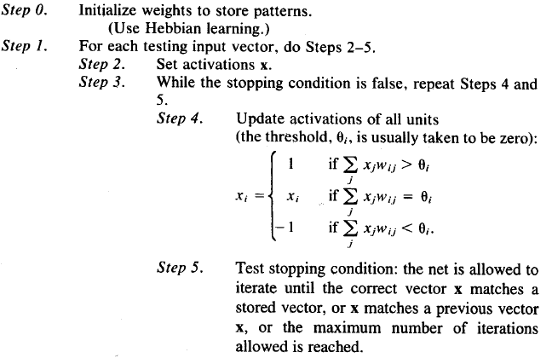
(Recurrent) Auto-Associative with threshold Function Algorithm:
* Here, Hebbian Learning is the same modified version.

Slide 20

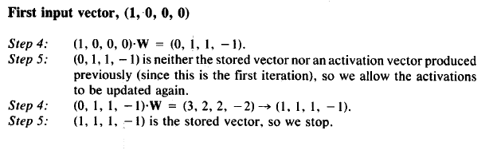
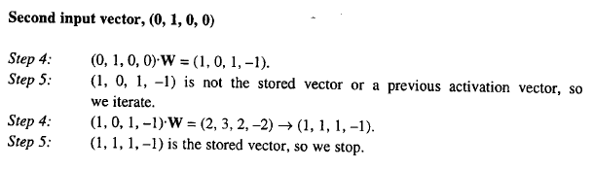
Example 1: store the vector (1,1,1,-1)
The Weight Matrix by Modified Hebbian
Learning Method
Three missing components
OK
Three missing components
OK

Slide 21
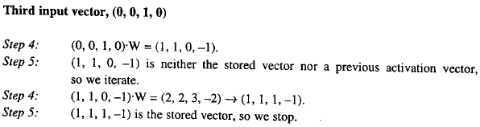
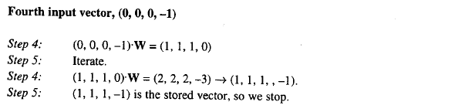
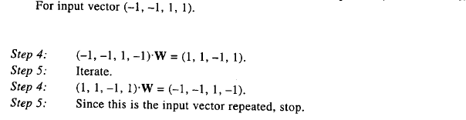
Three missing components
OK
Three missing components
OK
Three mistake components
(–1, –1, 1, 1) . W = (–1, –1, –1, 1)
(–1, –1, – 1, 1) . W = (–1, –1, –1, 1)
Not OK

Slide 22
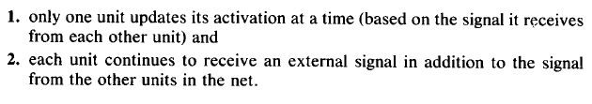
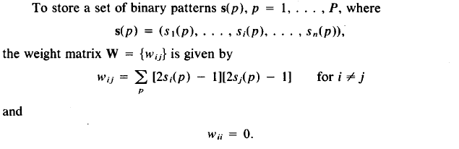
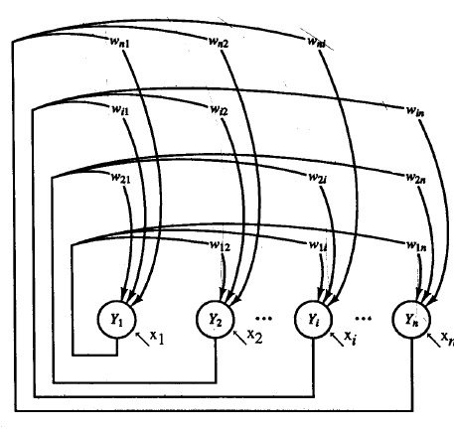
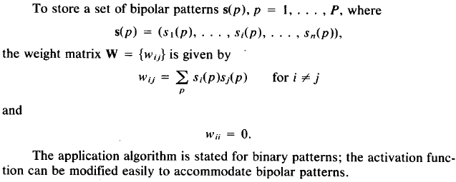
Discrete Hopfield Net (Hopfield 1982/1984)
Two Differences with the former Algorithm
Weight Matrix Initialization (Modified Hebbian Learning Method)

Slide 23
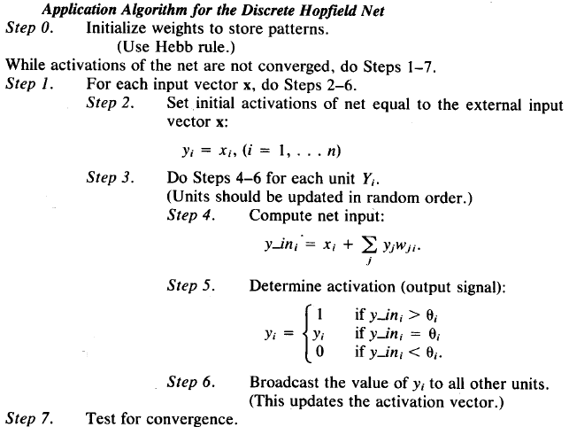

Slide 24
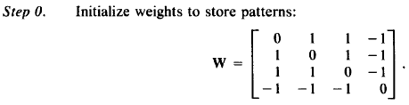
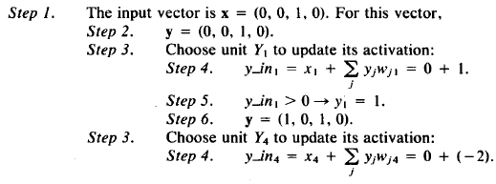
Example
Original (binary) stored pattern
Mistakes in the first and second components of the stored vector
Random Orders for computations: 1,4,3,2

Slide 25
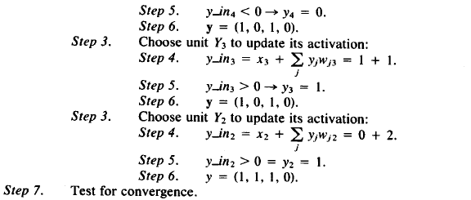
Important Notes
Hopfield has utilized the gradient of a quadratic function as recurrent rules for output units of the network.
Repeating such recurrent rules causes that the energy function converges to a local minimum point and the output pattern will converge to a certain pattern.

Slide 26


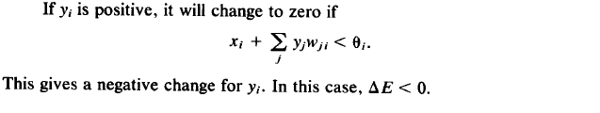
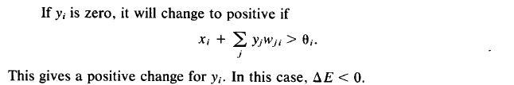
Proof:
Consider following Energy Function
The Energy Function has a limited lower bound

Slide 27
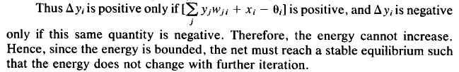
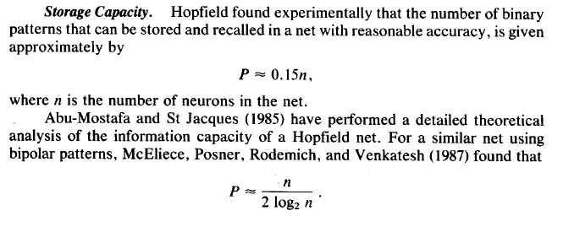

Slide 28
How to utilize Hebbian Memory Networks for (1) non-orthogonal, (2) analogue input patterns (3) with high enough capacity?
For Arbitrary number of non-orthogonal analogue inputs:
(1) Provide a transformation function to generate bipolar patterns from input analogue patterns.
The dimension of the bipolar patterns must be more than or equal to the number of input patterns
The generated bipolar patterns must be linearly independent form each other.
the order of distances of any analogue input pattern with all other input patterns must be seen in bipolar patterns, too.
(2) Provide a transformation matrix to get orthogonal bipolar form of the former generated bipolar patterns.
(3) Use Hebbian Learning Rule to store the required patterns

Slide 29

Restoring arbitrary number of patterns without dimension extending and orthogonal transformation
Assume it is aimed to train a network which associate different input patterns {S_{i} i=1,2..,P} to target patterns {t_{i} i=1,2..,P} .
Define a nonlinear scalar function with n-dimensional input variable: y=f(x). Such function must have at least “P” local minimum points :{y=f_{i} i=1,2..,P} at {x=S_{i} i=1,2..,P} .
Assume that each local minimum point (y=f_{i}) denotes the output patterns (t_{i}) and for two equal (not equal) output patterns two corresponding levels are equal (not equal) .
Now define a network which has two sequenced parts. At the First part the Network in a recurrent structure updates the input pattern by Gradient descent of the defined function. At the second part the Network produce the output of the function based on the updated input (by the first part).
It is expected that the network at first part converges to an input pattern (S_{j}) and in the second part (f_{j}) will be appeared which is considered as a label for (t_{j}).

Slide 30
Capacity of one layer MNN in restoring input patterns
For n-dimensional orthogonal input patterns
Auto-Associative Bipolar patterns | Hetro-Associative | Weight Matrix
“Capacity =n” | “Capacity =n” | Hebbian Matrix
“Capacity =n-1” | - | Modified Hebbian Matrix
Two important notes
For Auto-associative MNNs each stored vector is an Eigen-vector of the weight matrix of the network.
If additive disturbance of an input pattern (with arbitrary norm) are defined in nullity space of the weight matrix, the network will have unlimited robustness against it. Hence, it is suggested to use a low percentage of the whole capacity for restoring patterns.

Slide 31
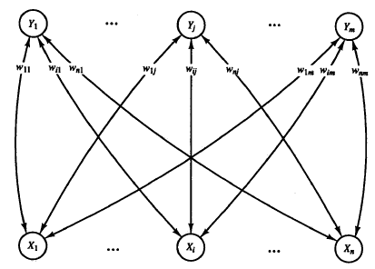
Bidirectional Associative Memory (BAM)
x₁
y₁
x_{i}
y_{j}
y_{m}
x_{n}
Repeat up to Stop Condition
This Network is a recurrent form of Hetro-Associative Network
At First, two disturbed and deformed patterns of s(p) and t(p) are assigned to “x” and “y” as two entrances of the network.
Using a bidirectional pattern association finally two input and output patterns converged to certain pair of patterns.
It is expected that s(p) and t(p) being final retrieved patterns. Other wise the network has failed to associate to the restored original patterns.

Slide 32
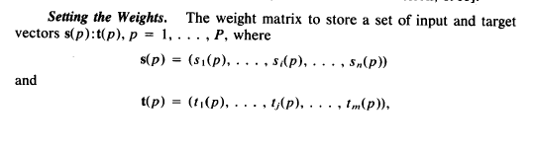
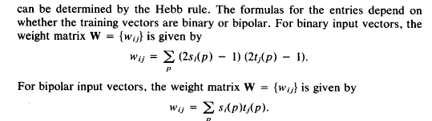
Setting the weights

Slide 33
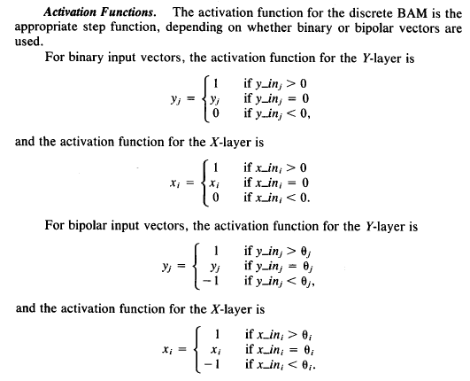
Activation Function

Slide 34
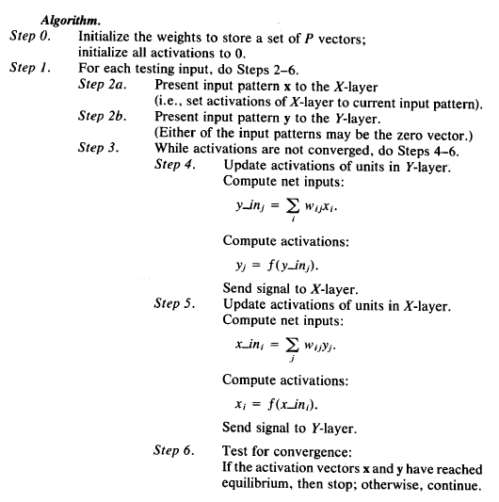
Algorithm

Slide 35
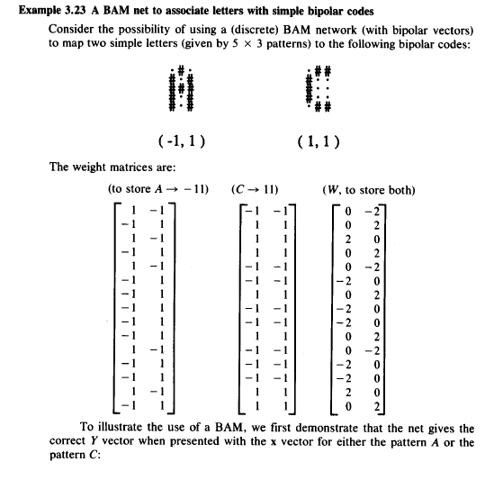
Example

Slide 36
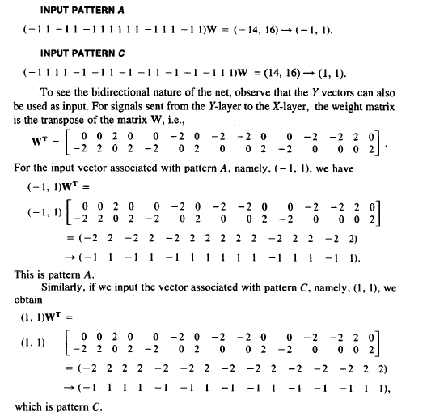
Verification for original patterns (former example)

Slide 37
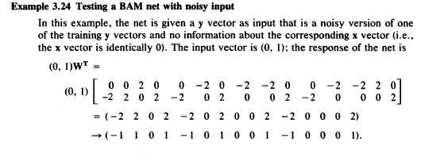
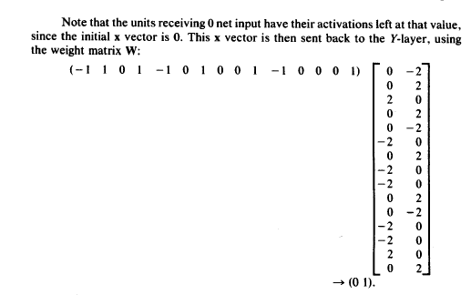
test for noisy patterns (former example)
Converged to non-original patterns

Slide 38
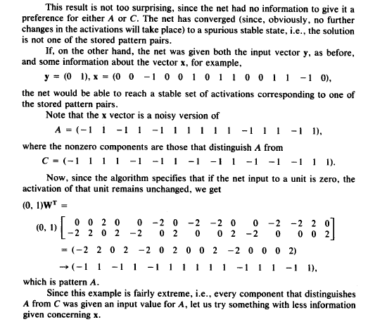
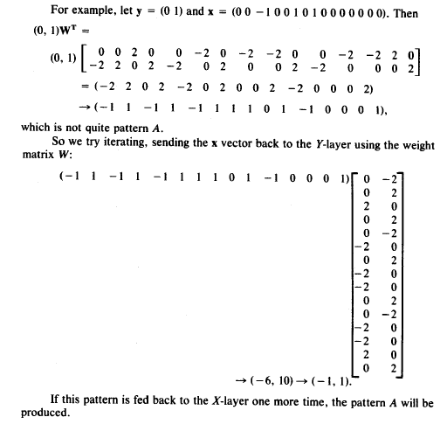
test for noisy patterns with modifications (former example)

Slide 39
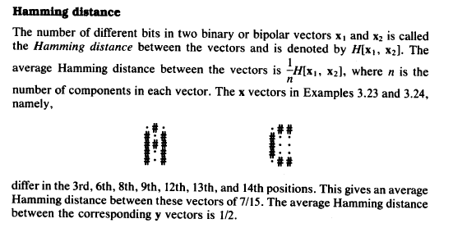
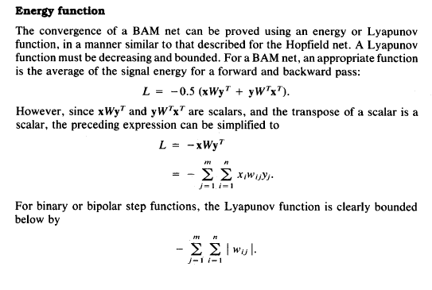
Two notes

Slide 40
2.1 MNNs with Implicit input patterns
Some known Recurrent NNs
Recurrent Neural Networks(RNNs)
Long-Short Term Memory (LSTM)
Gated Recurrent Unit (GRU)
Such Networks make nonlinear non-homogenous difference Equations. By solving such equations, the nonlinear functions, which generate the output patterns based on the implicit sequenced input patterns, are revealed.
Recurrent structures will make a plenty of memories utilized in pattern associations between implicit inputs and target outputs.
Pattern Association (Memories) types.
One to one: many classification problems and identification by fingerprint/biometric signals/signature/…
Many to one: voice/handwriting/walking in identification
One to Many-: image captioning/video captioning
Many to Many -- Translation machines...text to picture/Video

Slide 41
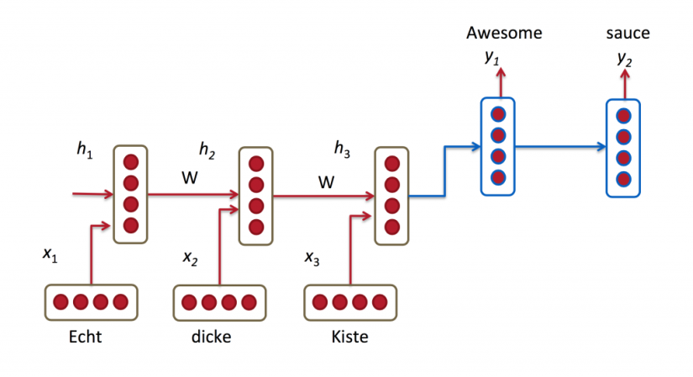
Some Applications of RNNs
Language Modeling and Generating Text
Recurrent neural network based language model
Extensions of Recurrent neural network based language model
Generating Text with Recurrent Neural Networks
Machine Translation
A Recursive Recurrent Neural Network for Statistical Machine Translation
Sequence to Sequence Learning with Neural Networks
Joint Language and Translation Modeling with Recurrent Neural Networks
Given a sequence of words we want to predict the probability of each word given the previous words. Language Models allow us to measure how likely a sentence is, which is an important input for Machine Translation (since high-probability sentences are typically correct).
Machine Translation is similar to language modeling in that our input is a sequence of words in our source language (e.g. German). We want to output a sequence of words in our target language (e.g. English).

Slide 42
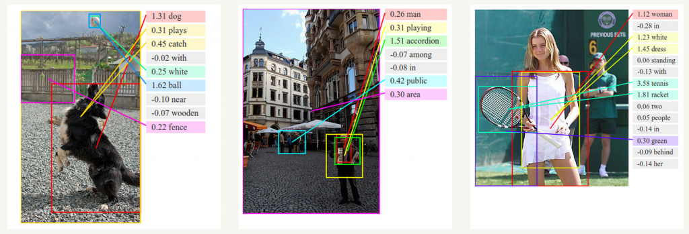
Some Applications of RNNs
3. Speech Recognition
Given an input sequence of acoustic signals from a sound wave, we can predict a sequence of phonetic segments together with their probabilities.
Towards End-to-End Speech Recognition with Recurrent Neural Networks
4. Generating Image Descriptions
Together with convolutional Neural Networks, RNNs have been used as part of a model to generate descriptions for unlabeled images

Slide 43
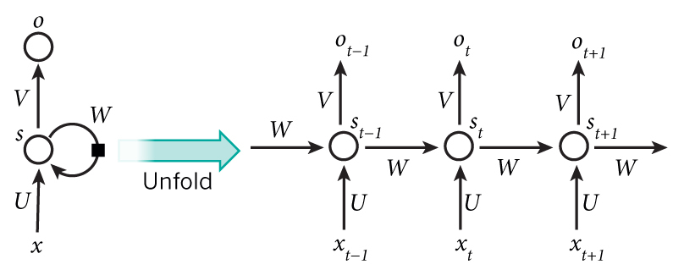


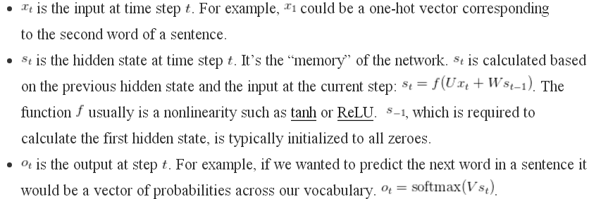
A Typical RNN

Slide 44
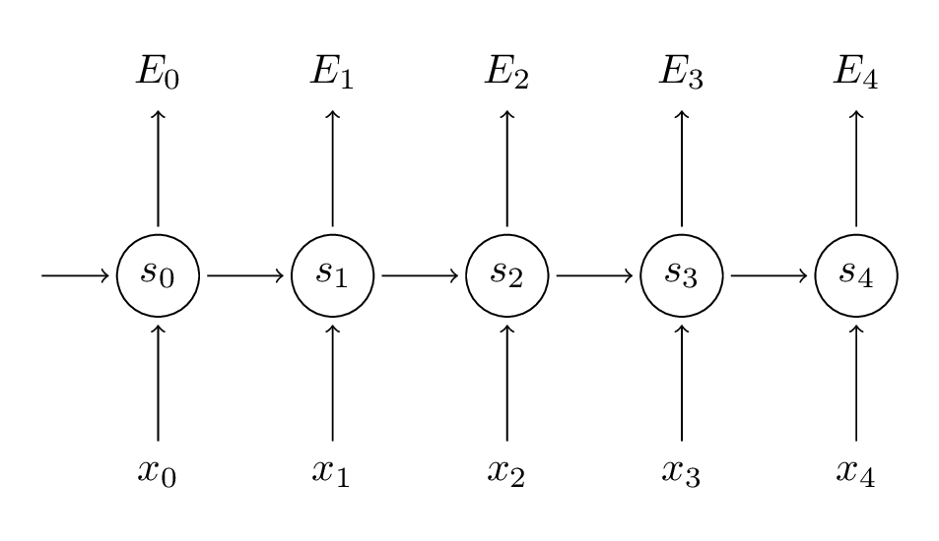
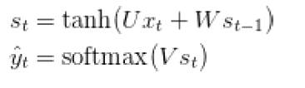






Training RNNs
Back Propagation Through Time (BPTT)
Loss function
Updating Rules(for t=3)

Slide 45

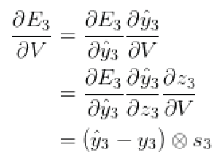

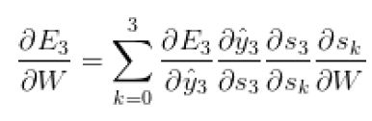

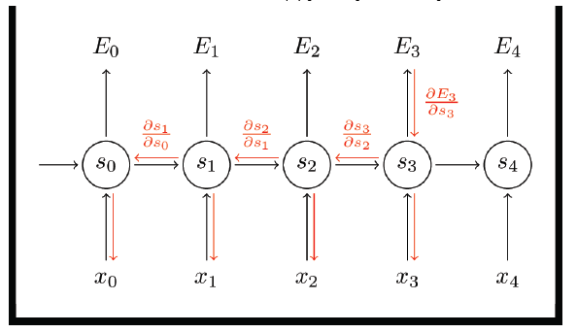
Back Propagation Through Time (BPTT)

Slide 46
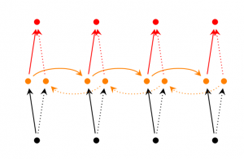
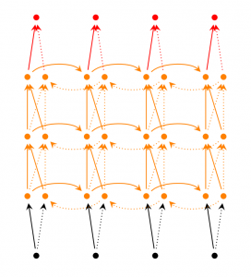
RNN Extensions
Bidirectional RNNs are based on the idea that the output at time may not only depend on the previous elements in the sequence, but also future elements. For example, to predict a missing word in a sequence you want to look at both the left and the right context. Bidirectional RNNs are quite simple. They are just two RNNs stacked on top of each other. The output is then computed based on the hidden state of both RNNs.
Deep (Bidirectional) RNNs are similar to Bidirectional RNNs, only that we now have multiple layers per time step. In practice this gives us a higher learning capacity (but we also need a lot of training data)

Slide 47




Main limitation in RNN
derivative of sigmoid functions is less than one.
In “BPTT” when the RNN is unfolded for many times the back-propagated gradient coefficient is vanished for the inputs taken at older times.
The learning for long dependencies is not effective any more.
Error gradients vanish exponentially quickly with the size of the time lag between important events

Slide 48
RNNs are good to make Short Term Memory
RNNs are not good to make Long Term Memory
The clouds are in the SKY
implicit input → target
I grew up in France………....I speak fluent French
implicit input →? target
?

Slide 49
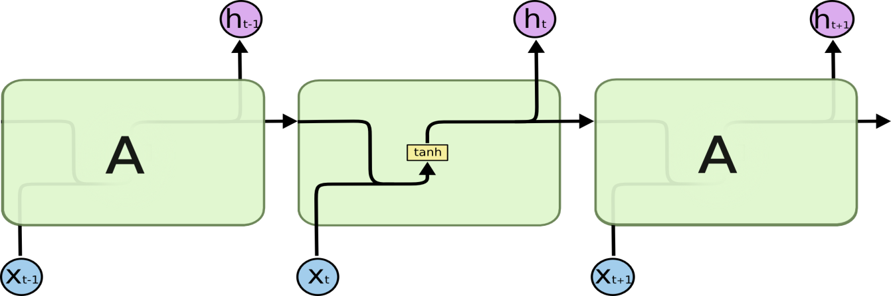

LSTM (long short term memory) Hochreitor & Shmidhuber 1997
Module in RNN
(h_{t} is the same s_{t})
h_{t} =tanh(Ux_{t}+W h_{t-1})
The repeating module in a standard RNN contains a single layer.
Module in LSTM
The repeating module in an LSTM contains four interacting layers.
the LSTM can read, write and delete information from its memory.

Slide 50
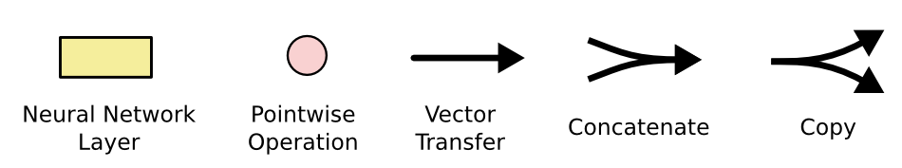
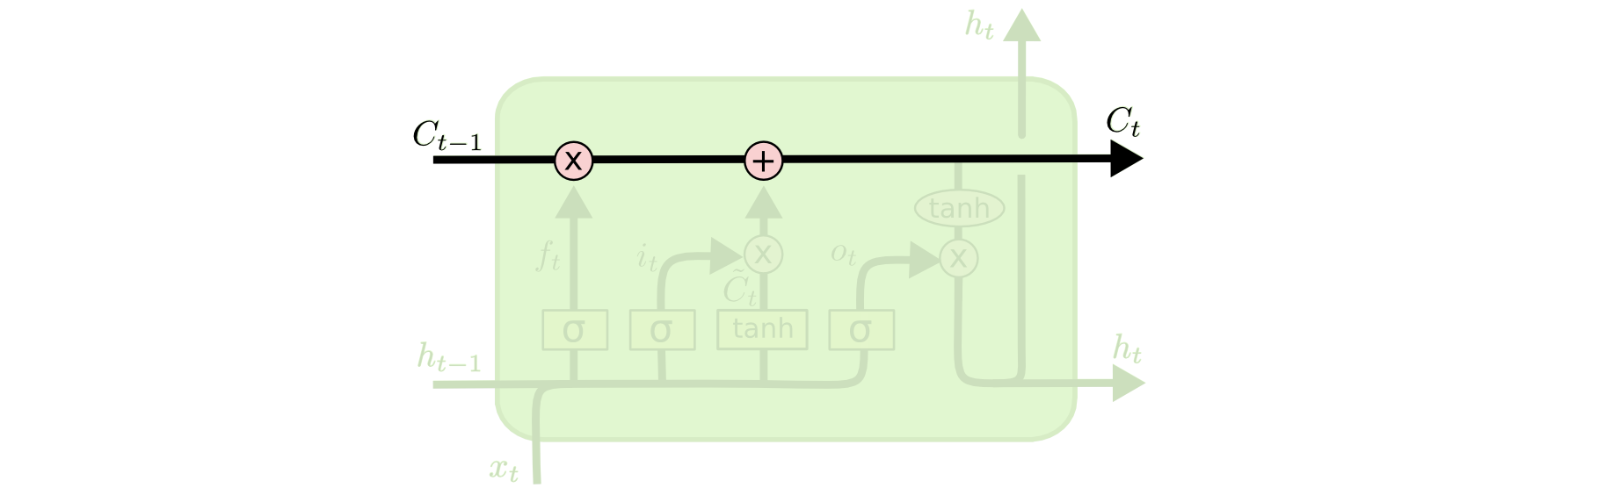
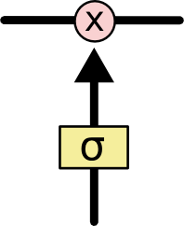
Some Concepts
The notation
Two key concepts in LSTMs
1. Cell state
2. Gate
Gates are a way to optionally let information through.
They are composed out of a sigmoid neural net layer and a pointwise multiplication operation.

Slide 51

Step-by-Step LSTM Walk Through
Step1: to decide what information we’re going to throw away from the cell state.
A Gate for
Saving/Deleting Memory
Forget Gate

Slide 52

Step2: to decide what new information we’re going to store in the cell state.
A Gate for Writing to Memory
Input Gate

Slide 53

Step3: drop the information about the old subject’s gender and add the new information, as we decided in the previous steps.
Deleting/Saving and Writing to Memory

Slide 54

Step4: to decide what we’re going to output
Reading from Memory
Output Gate

Slide 55




Compact Form Equations

Slide 56


Parameters are updated by “BPTT” All computed gradients of parameters are added together through the time

Slide 57
LSTM Learning methods
Like RNN, “BPTT” can be performed to learn the weights and biases of a LSTM module. Unlike standard RNNs, the error remains in the unit's memory.
LSTM can also be trained by a combination of artificial evolution for weights to the hidden units, and pseudo-inverse or support vector machines for weights to the output units.
In reinforcement learning applications LSTM can be trained by policy gradient methods, evolution strategies or genetic algorithms.

Slide 58

LSTM Forward and Backward Pass, Arun Mallya

Slide 59


Slide 60


Slide 61


Slide 62



Slide 63

There are two parallel Forward passes

Slide 64

There are two parallel backward passes

Slide 65


Slide 66


Slide 67


Slide 68


Slide 69


Slide 70

Extended Versions
1. One popular LSTM variant, introduced by Gers & Schmidhuber (2000), is adding “peephole connections.” This means that we let the gate layers look at the cell state.

Slide 71

2. Another variation is to use coupled forget and input gates. Instead of separately deciding what to forget and what we should add new information to, we make those decisions together. We only forget when we’re going to input something in its place. We only input new values to the state when we forget something older.

Slide 72

3. A slightly more dramatic variation on the LSTM is the Gated Recurrent Unit, or GRU, introduced by Cho, et al. (2014). It combines the forget and input gates into a single “update gate.” It also merges the cell state and hidden state, and makes some other changes. The resulting model is simpler than standard LSTM models, and has been growing increasingly popular.

Slide 73
Thank you
End of Chapter 3

